Slide 1
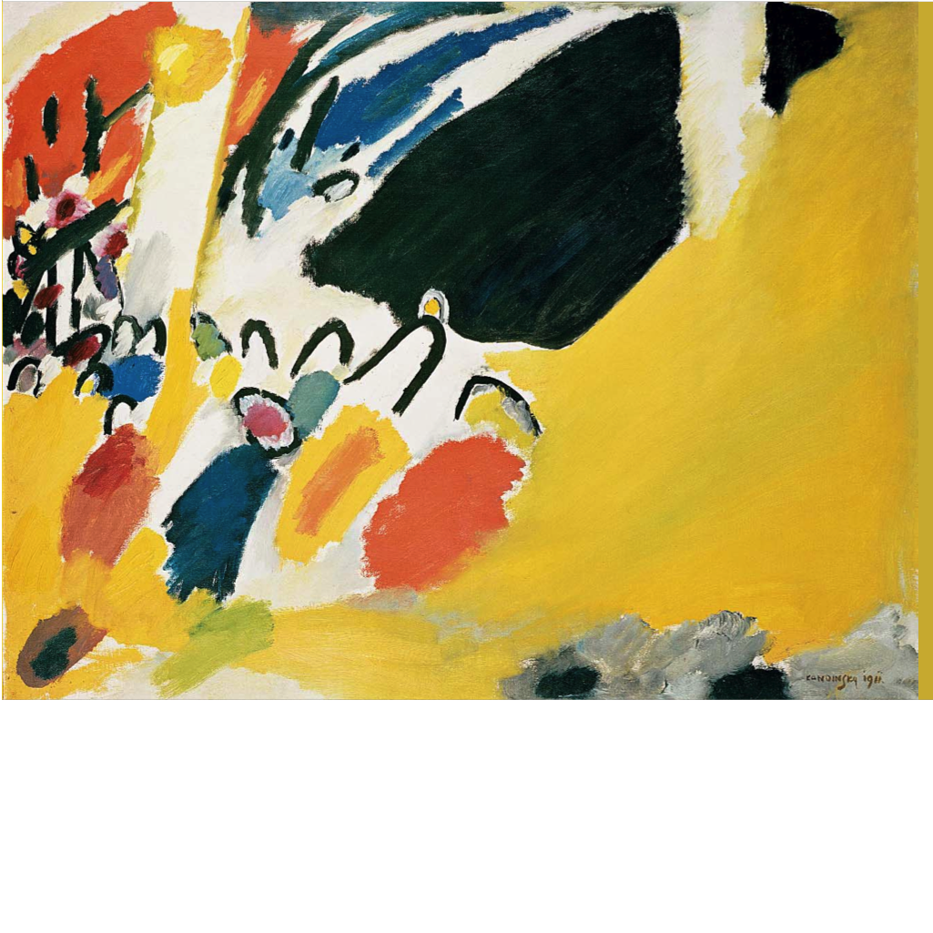
The Crisis In Information Security
Adam Shostack
Notes:
1.01
I’m here to talk to you today about the crisis in information security, why it exists, and what we can do about it. Before I get started, I’d like to be clear that when I say I, I mean I, and would like to be clear that (next slide)

Slide 2
Disclaimer
These opinions are mine, and don’t represent those of
Microsoft
any US-based investment bank
the Tri-lateral Commission
Wikipedia
But do represent Andrew Stewart & myself

Slide 3
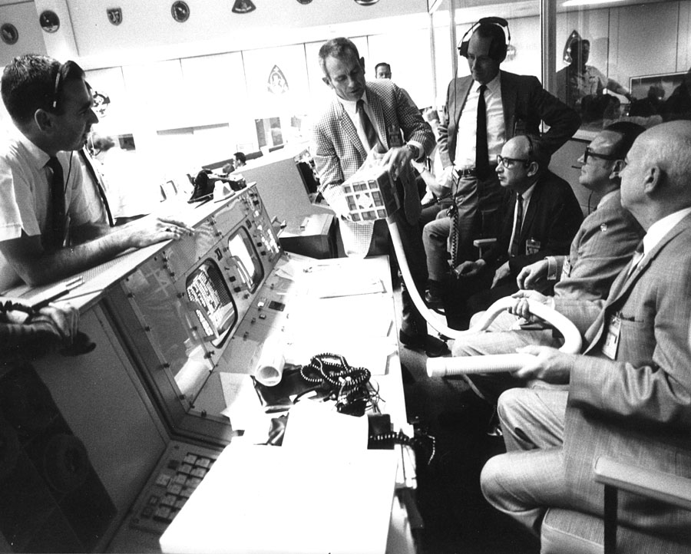
We have a problem
Photo: NASA http://history.nasa.gov/alsj/a13/ap13-S70-35013.jpg
Notes:
Crisis of credibility. Unlike NASA, no one believes us when we say to wrap the box in socks.
Management doesn’t believe us. Our families don’t believe us. We have a credibiltiy gap.
Some people don’t believe that, they say we’re making progress. Wave issa journal
http://history.nasa.gov/alsj/a13/ap13-S70-35013.jpg

Slide 4
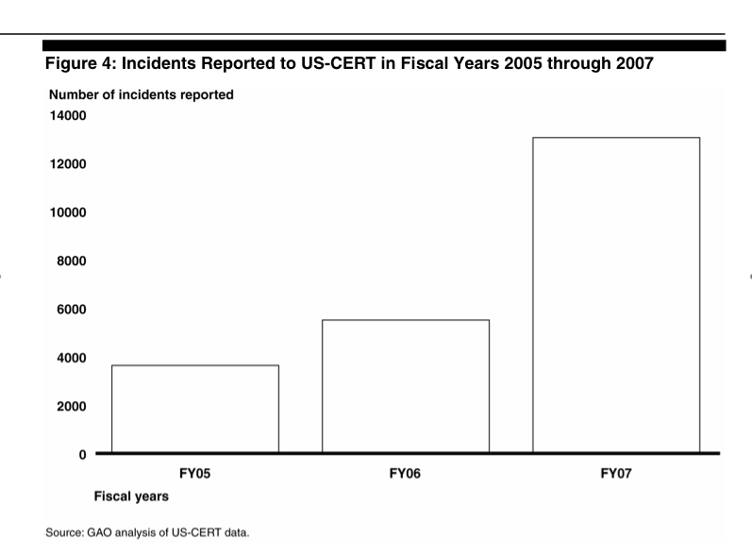
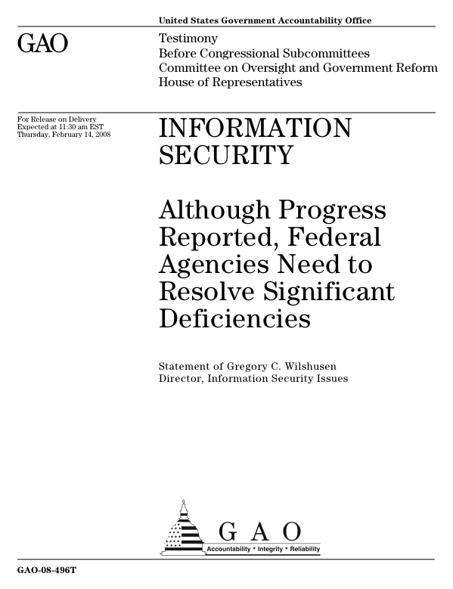
How much progress can we take?
Notes:
Tripling of incidents reported. (Detected?)
Some people say we’re measuring the wrong things
Feb 14 2008
http://www.gao.gov/new.items/d08496t.pdf

Slide 5
Are we measuring the right things?
Notes:
Does it need to be this hard?

Slide 6
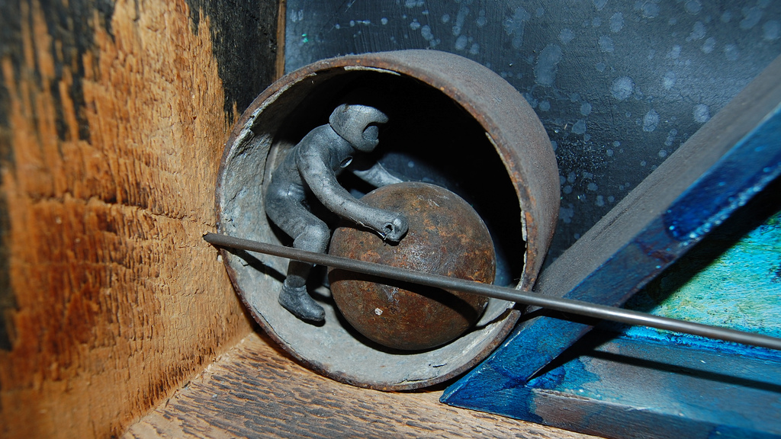
It doesn’t have to be this hard
Photo: Theorris, Myth of Sisyphus (detail): Captain Sisyphus http://flickr.com/photos/signifying/2073074572/
Notes:
http://flickr.com/photos/signifying/2073074572/ Myth of Sisyphus (detail): Captain Sisyphus

Slide 7
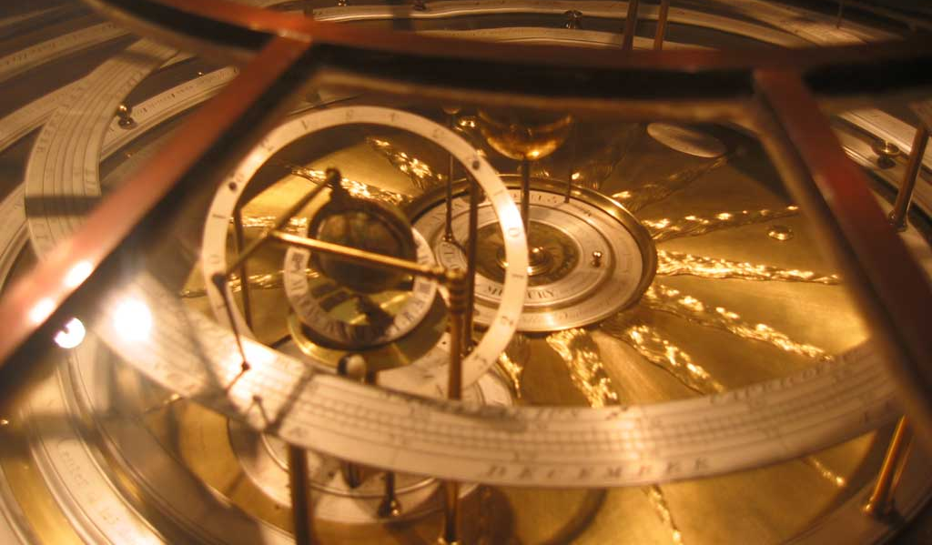
People solve complex problems
Photo: ElDave, Astrolabe, http://flickr.com/photos/eldave/40717897/

Slide 8
Sometimes without computers
The orbit of every planet is an ellipse with the sun at one of the foci
A line joining a planet and the sun sweeps out equal areas during equal intervals of time
The squares of the orbital periods of planets are directly proportional to the cubes of the semi-major axis of the orbits
(Kepler, by observation)
Notes:
Johannes Kepler, early 1600s.
It’s not just technical & physics problems

Slide 9
People solve complex problems
Smallpox
Deadliest disease in history
1900-1979
500 million victims died
15 million per year in 60s
½ of all blindness in Asia
Photo: Wikimedia
Notes:
Ali Maow Maalin, 1977, was the last person in the world known to be infected with naturally occurring smallpox

Slide 10
People solve complex problems
Smallpox
Deadliest disease in history
1900-2000
500 million victims died
15 million per year in 60s
½ of all blindness in Asia
WHO campaign to eradicate the disease
Photo: Wikimedia
Notes:
Ali Maow Maalin, 1977, was the last person in the world known to be infected with naturally occurring smallpox
I’d like to talk about how we solve problem

Slide 11
Observe
Photo: Smirnoff Green Apple Vodka ad (cropped) http://adsoftheworld.com/media/print/smirnoff_green_apple_twist_newton

Slide 12
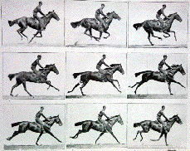
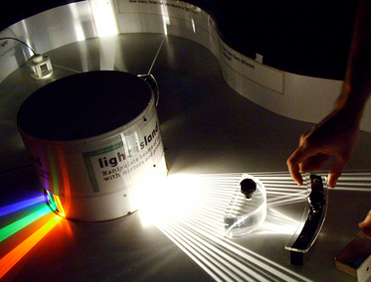
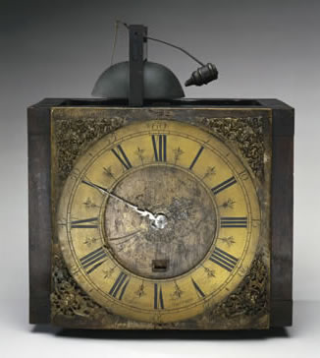
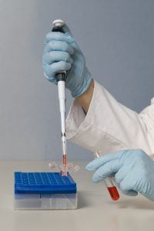
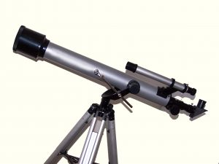
(Sometimes, you need instruments)
Notes:
Eadweard J. Muybridge, collaborating with Leland Stanford (has a small school named after him), invented high speed photography.

Slide 13
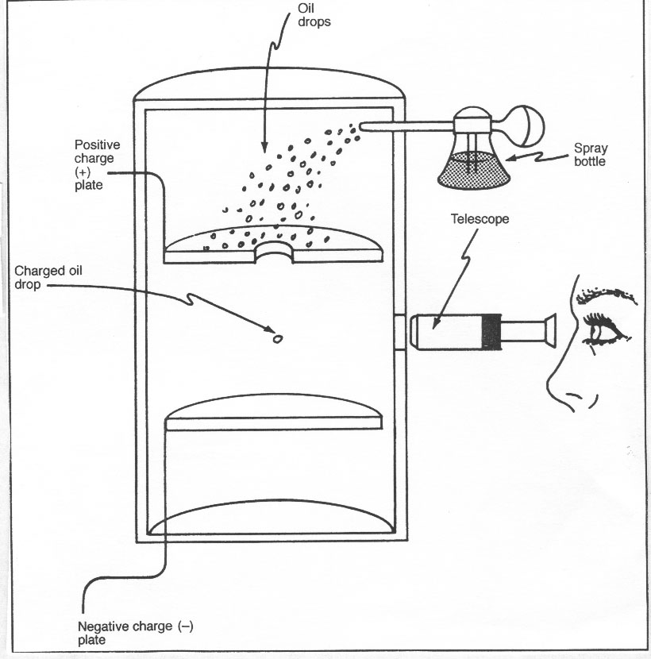
(Arrange for observations)
Notes:
Robert Millikan’s oil drop experiment, http://amorosochem.tripod.com/atomicstructure.htm
This diagram doesn’t show the bright light

Slide 14
Scientific Method (in a nutshell)
Form an interesting hypothesis
Surprising
Broad
Predictive
Testable
Find a method of testing it
Try to prove it wrong
Observation
Experimentation
Notes:
Prove it wrong is important
Experimentation is great when you can do it. Hard to experiment in astrophysics, medicine or health.

Slide 15
Scientific Method vs. Security Method
Form an interesting hypothesis
Advocate for it really loudly
Assert that it’s a really big problem
Give it a cutesy name
Where do we get data to test hypotheses?
http://security4all.blogspot.com/2007/06/spear-phishing-and-whaling.html
Notes:
Interesting hypotheses:
“People who attend ISSA conferences experience 25% less spam”
“Companies which employ CISSPs are broken into 10% less frequently”
Firewall brand X has a 30% lower TCO than brand Y

Slide 16
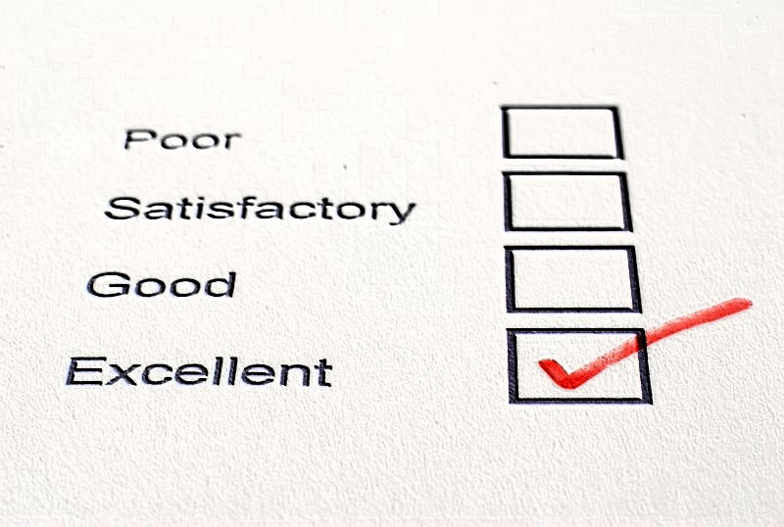
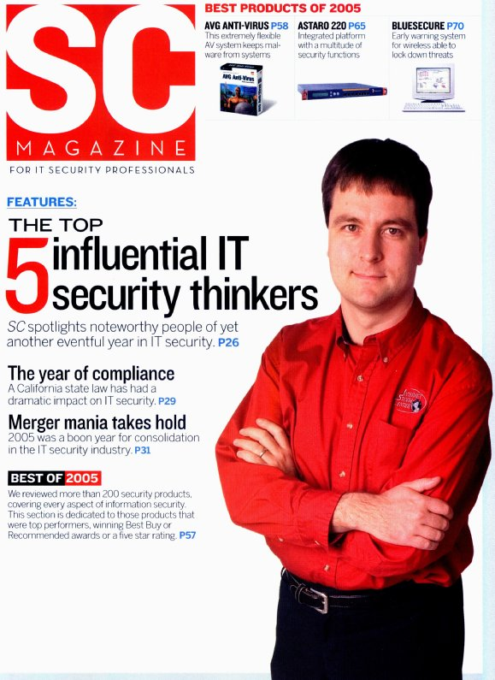
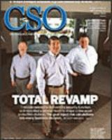
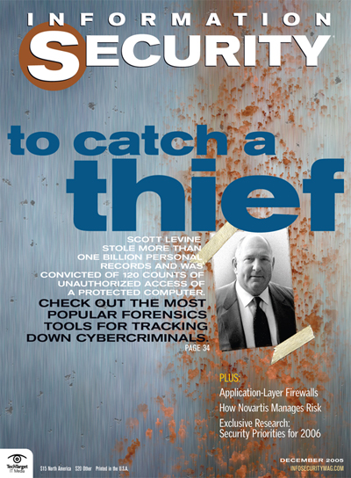
Some possible data sources
Surveys
The trade press
Vulnerability data from bugtraq etc
Honeynets
Experience: organizational or personal
What is good data?
How good are these?

Slide 17
Why we want data
Test hypotheses and disprove them
Help address key underlying questions
What causes security pain?
How can we reduce it?
How effective is this spending versus alternatives (including insurance?)
Get budget & authority to deliver securely
By making executives happy
Notes:
Securely vs security is intentional: we want to deliver not security, but deliver something else with the “right” degree of security

Slide 18
John Snow and Cholera
Notes:
Snow wallowing in data, and risking his life to talk to people in the face of an unknown disease in 1854

Slide 19
The rise of breach data
California SB 1386 & 41 other state laws
Require notification to customers of certain breaches involving loss of control of personally identifiable information
Goal was to reduce the impact of id theft/impersonation fraud
Opportunity to study what goes wrong
(Thanks, Choicepoint!)

Slide 20
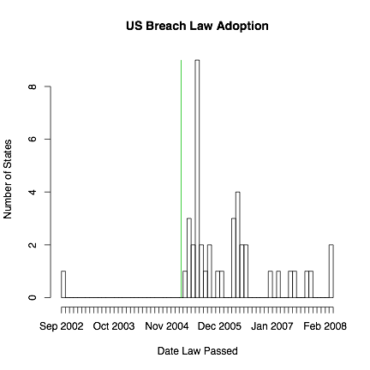
The rise of breach laws
Choicepoint

Slide 21
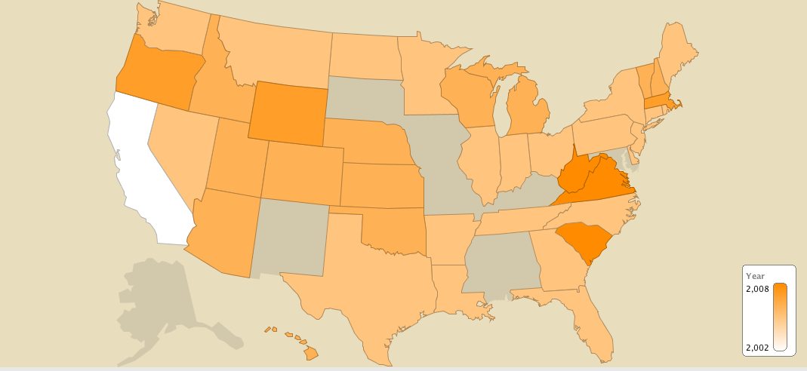
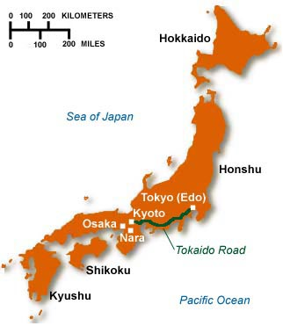
Rise of Breach Laws
Data: National Council of State Legislatures, Perkins Coie, Proskauer Rose
Graphic: IBM Many Eyes, Chris Walsh

Slide 22
What breaches can teach us
The sky doesn’t fall
Many concerns haven’t materialized
Customers fleeing
Companies going out of business
Massive lawsuits
(All your counterexamples are outliers)
(TJX, CPS, CardSystems are a very few out of 950 incidents tracked at attrition.org/dataloss)
It’s better to talk abut problems
Real world examples deliver credibility

Slide 23
What we can learn from data
Notes:
Wallow in the data. Get your hands dirty. And most importantly, what goes wrong.

Slide 24
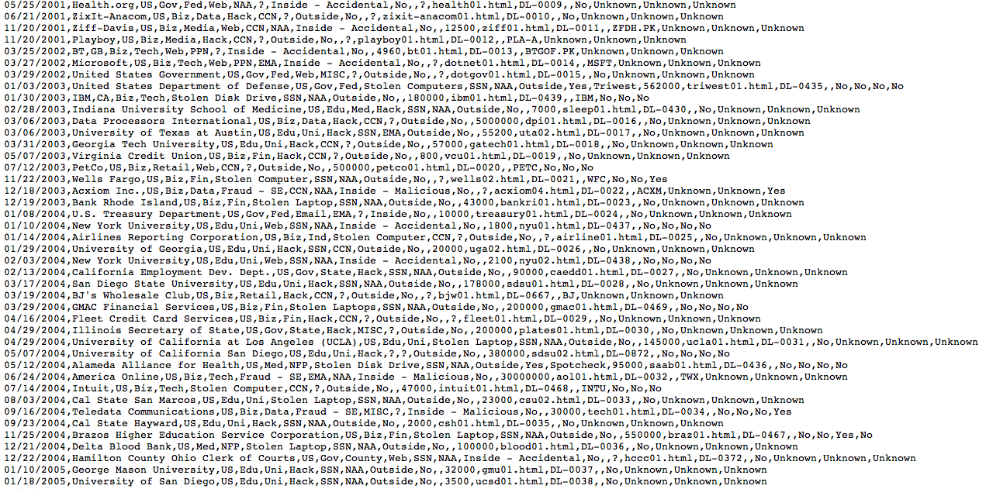
attrition.org/dataloss/dataloss.csv
Notes:
The data doesn’t tell us things. But it lets us test hypothesis. Better than Ponemon reports in that it lets you wallow in the data yourself. Worse, because there’s fewer details.

Slide 25
Causes of (PII) breaches

Slide 26
Causes of breaches (2)
…with 45% of women versus 10% of men prepared to give away their password, to strangers masquerading as market researches with the lure of a chocolate bar as an incentive for filling in the survey…
Photo: http://blogs.guardian.co.uk/technology/2008/04/16/woman_4_times_more_likely_than_men_to_give_passwords_for_chocolate.html
Notes:
We’ll come back to this.
http://blogs.guardian.co.uk/technology/2008/04/16/woman_4_times_more_likely_than_men_to_give_passwords_for_chocolate.html

Slide 27
Breach Data is a step forward
Gives us something like random sampling
What problems can we apply it to?
How do we analyze the data?
The sky hasn’t fallen
We gain credibility by talking about the problems
Notes:
Transition to talking to how we talk about the problem

Slide 28
Intros to information security
Take many forms:
Operating systems, apps, networks
Development, deployment and operations
Saltzer & Schroeder, Bell-LaPadula, Biba
People, process, technology
RSA, AES, HMAC, SHA-2
Notes:
Security people know security tech, so I’m going to talk less about security tech here, and even say that technology is needed to solve technology problems, but most of the problems which can be solved by technology have been solved by technology.
Talk about one particular form

Slide 29
Introduction to Network Security?
(Stephan Brands, Rethinking Public Key Infrastructures and Digital Certificates; Building in Privacy)
Notes:
Crypto is a great building block.
We need technology. But technology doesn’t solve all its own problems.
, but its not the be-all, end-all

Slide 30
Markets that work
http://flickr.com/photos/stepcasssri/2418076055/
Notes:
Executives notice this stuff! They talk about markets!

Slide 31
Markets that don’t
Photo: Milk line in Russian city; women and children in long line waiting to buy milk; girl selling apples, Library of Congress, http://hdl.loc.gov/loc.pnp/cph.3b07132

Slide 32
Security Economics Issues
User behavior: passwords
Incentive alignment
Aggregate costs
Nash equilibriums & tech adoption
Chasm crossing
Insecure software
Transaction costs of evaluation

Slide 33
Psychology
http://www.loc.gov/exhibits/freud/images/95etcs.jpg
Notes:
Patching, risk compensation

Slide 34
Sociology
http://www.freud.org.uk/ground.htm
Notes:
First, an aside

Slide 35
Detail (above Freud’s couch)
http://www.reduplikation.net/IMG/jpg/charcot_blanche.jpg
Notes:
Diversity, identity, cell phones

Slide 36
Spending
Where people put their scarce resources tells you what they really care about
The coffee complaint
Gordon & Loeb’s 37%
The Economics of Information Security Investment, ACM Transactions on Information and System Security (TISSEC) V5, #4 (November 2002)

Slide 37
The road to Utopia
Photo: “Long road marked Start” by Caffe http://www.sxc.hu/photo/937726
Notes:
People are people, externalities don’t just go away, hci, language

Slide 38
What is the New School?
Learning from other professions, such as economics and psychology, to unlock the problems that stymie the security field. The way forward cannot be found solely in mathematics or technology
Sharing objective data and analysis widely. A fetish for secrecy has held us back.
The embrace of the scientific method for solving important security problems. Analyzing real world outcomes is the best way for information security to become a mature discipline.
…and a book which lays out these ideas in more detail
Notes:
Other than a book

Slide 39
Call to action
Join the New School
Gather good data
Analyze good data
Seek new perspectives
Change how you teach and learn
Make money from the New School

Slide 40
Thank you! Questions?
Notes:
My name’s Adam, and I’m an information security professional. They say the first step is admitting you have a problem.

